Slide 1
Nutriton education: Training day and rest day nutrition
Célia Bastin – November 22nd, 2024

Slide 2
Objectives
By the end of this lesson, all the athletes will be able to:
Discuss how to make balanced adjustments
Create one pre-practice breakfast
Name the 3 different macronutrients
Identify the different food groups represented on my plate

Slide 3
Training day nutrition
Tell me what is your last meal before a practice

Slide 4
Training day nutrition
Balancing macronutrients for sustained energy:
Carbohydrates
Protein
Fats

Slide 5
Training day nutrition
Carbohydrates:
Important for athletic performance (brain and body’s preferred source of energy)
Body stores carbs in glycogen which can be found in muscle tissues, during a workout your body energizes itself by breaking down those stored carbs

Slide 6
Training day nutrition
Carbohydrates
Simple | Complex
Processed food: Cookies Cakes White bread Pretzels Fruit juices Sodas Candy Energy gel Energy drinks | Whole grains Whole fruits Whole vegetables Dried fruits

Slide 7
Training day nutrition
Proteins:
Help your body builds muscles
Keep you full
Improve brain function

Slide 8
Training day nutrition
Proteins
Animal-based | Plant-based
All animal products: Meat Dairy Eggs | Nuts Seeds Beans Lentils Oats Milk alternatives Meat alternatives

Slide 9
Training day nutrition
Fats:
Important for hormone regulation
Help your body absorb vitamins (A, D, E and K)

Slide 10
Training day nutrition
Fats
Unsaturated fats | Saturated fats
Fatty fish (salmon, cod, tuna, …) Avocados Plants oil and fish oil EXCEPT coconut and palm oil Flaxseeds | Processed foods: Snack Beef, pork, poultry, lamb, goat, … Baked goods Fried food Dairy products
Notes:
Coconut, animal, palm oil = saturated fats plants oil and fish oil= unsaturated oils EXCEPT Coconut, palm oil

Slide 11
Training day nutrition
Notes:
Not all oils are unsaturated so it’s important to be able to make the difference

Slide 12
Training day nutrition
How can you make some balanced adjustments to your last meal before practice?

Slide 13
Training day nutrition
Demonstration:
Talk about some easy breakfast that can be prepared and eaten on the way to practice

Slide 14
Training day nutrition
https://www.allrecipes.com/recipe/244251/no-cook-overnight-oatmeal/
https://www.pastrywishes.com/greek-yogurt-with-granola/

Slide 15
Rest day nutrition
What kind of meal you like to prepare on your days-off

Slide 16
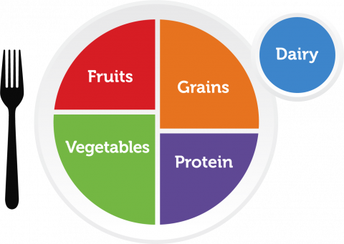
Rest day nutrition

Slide 17
Rest day nutrition
Fruits (all fruits and 100% fruit juice)
Can be eaten: Whole Cut up Puréed (mashed) Cooked
Frozen Fresh Canned Dried/dehydrated

Slide 18
Rest day nutrition
Vegetables (any vegetable or 100% juice)
Can be eaten: Whole Cut up Puréed (mashed) Cooked Raw
Frozen Fresh Canned Dried

Slide 19
Rest day nutrition
Grains
Foods made from: Wheat Rice Oats Cornmeal Barley Another cereal grain
Examples: Bread Pasta Breakfast cereals Grits Tortillas Popcorn Rice Oatmeal

Slide 20
Rest day nutrition
Protein
Seafood (higher in healthy fatty acids) Meat (lean or low fat) Poultry (lean or low fat) Eggs
Beans Peas Lentils Nuts Seeds Soy products

Slide 21
Rest day nutrition
Dairy
Milk Yogurt Cheese Lactose-free milk Fortified soy milk and yogurt
DOES NOT INCLUDE: Cream cheese Sour cream Cream Butter

Slide 22
Post assessment
https://create.kahoot.it/share/nutrition-education-presentation/772d280e-326c-4830-b50f-2e14afd1db8f

Slide 23

Handout

Slide 24
References
https://recreation.gsu.edu/2024/07/01/macro-guide/#:~:text=For%20exercise%20lasting%20more%20than,glycogen%20stores%20and%20rebuild%20muscles.
https://swell.uccs.edu/theathletesplate
https://www.myplate.gov

